Slide 1
Week 8
Cryptography Public Key systems, message digests, authentication, digital signatures

Slide 2
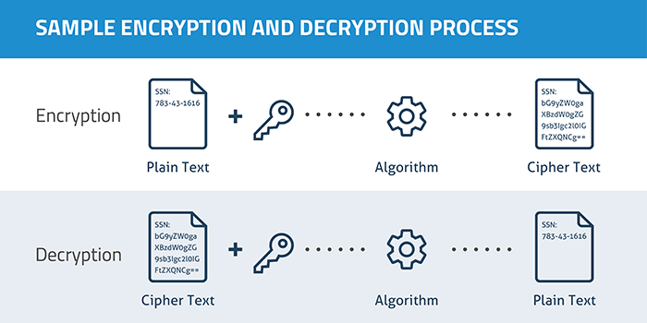
What is Encryption
Encryption
Decryption
Who cares?
https://en.wikipedia.org/wiki/Encryption

Slide 3
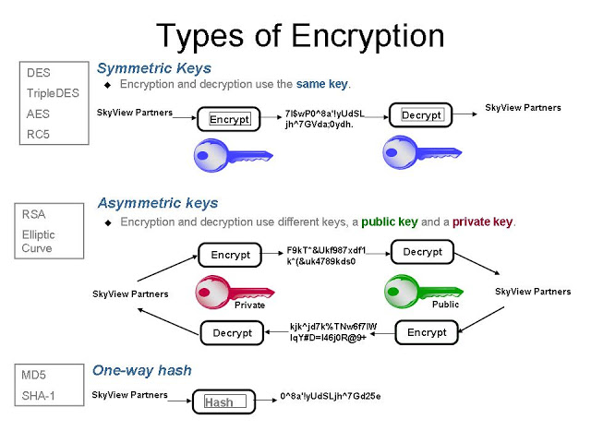
Symmetric vs Asymmetric
https://medium.com/@peterchang_82818/review-3-main-types-of-encryption-hash-symmetric-asymmetric-tutorial-example-understand-5e57c290324c

Slide 4
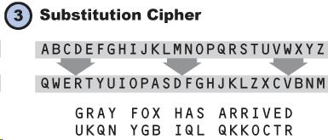
Example of symmetric encryption
https://en.wikipedia.org/wiki/Symmetric-key_algorithm

Slide 5
Computer encryption
Enigma machines
DES (Data Encryption Standard)
  Released 1977
  Triple DES
  Broken 1999
AES (Advanced Encryption Standard)
  Published 2001
  Used starting 2003 for NSA classified data

Slide 6
Cryptanalysis
Amount of info known
  Cipher text only or plaintext only
  Chosen plaintext
Frequency analysis

Slide 7
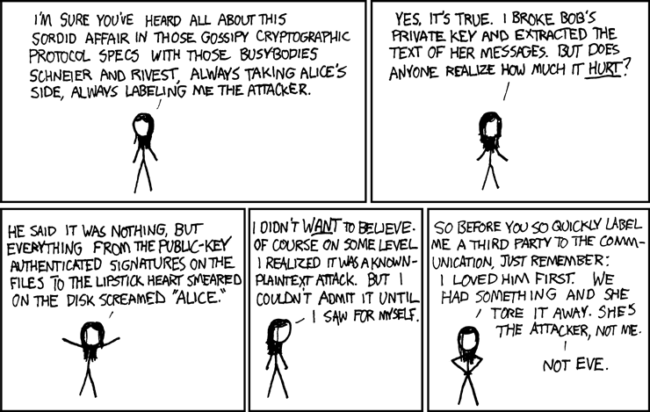
The love story of Alice and Bob
Public Key/Private key
  What happens if private key is lost?
Digital Signatures
One way functions/Hash functions
Demo! Princess rescued from the tower
https://xkcd.com/177/

Slide 8
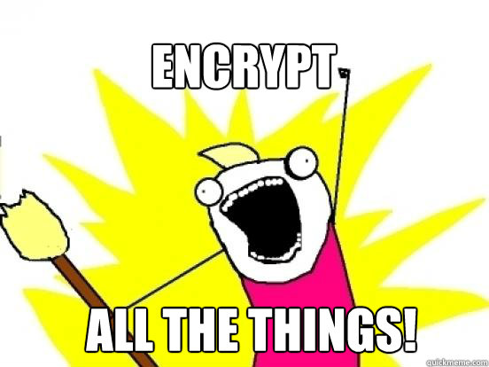
Encrypting Stored data
Mobile data
Cloud data
Backups
Password control and management

Slide 9
In Class Activity!
VeraCrypt https://www.veracrypt.fr/
You need to create an encrypted container. Open VeraCrypt and create a volume. Select encrypted container (the default). Make it a standard container. Select a directory to put it in and give it a name you will remember.
Use the default encryption and give it a size of 20 MB. Put in a simple password that you will remember (even though it will complain about a simple password). Go ahead and format the container.
Next you have to mount the container. Select an unused letter for the container, select the file and mount.
Create some files and put them in the container.
Dismount the container and look at the file in File Explorer. Include in the lab report the name of the file and the size.
To get at the files you have in the container, mount the container and open the files.

Slide 10

Encrypting Communications
Email
Chat
Timed encryptions

Slide 11
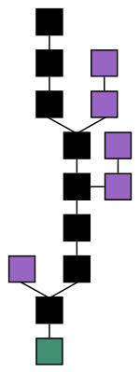

Blockchain
Continuously growing list of records
Blocks
  Linked and secured using cryptography
Secure by design
Example of Distributed computing
Bitcoin
https://en.wikipedia.org/wiki/Blockchain

Slide 12
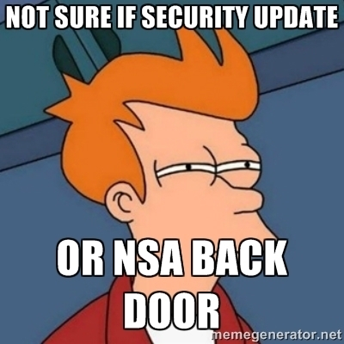
Legal issues
Backdoors vs Golden Keys
US restricts export of Cryptography (Export Administration Regulations, which replaced the International Traffic in Arms Regulations for most encryption
Key disclosure laws
  In re Boucher

